Slide 1
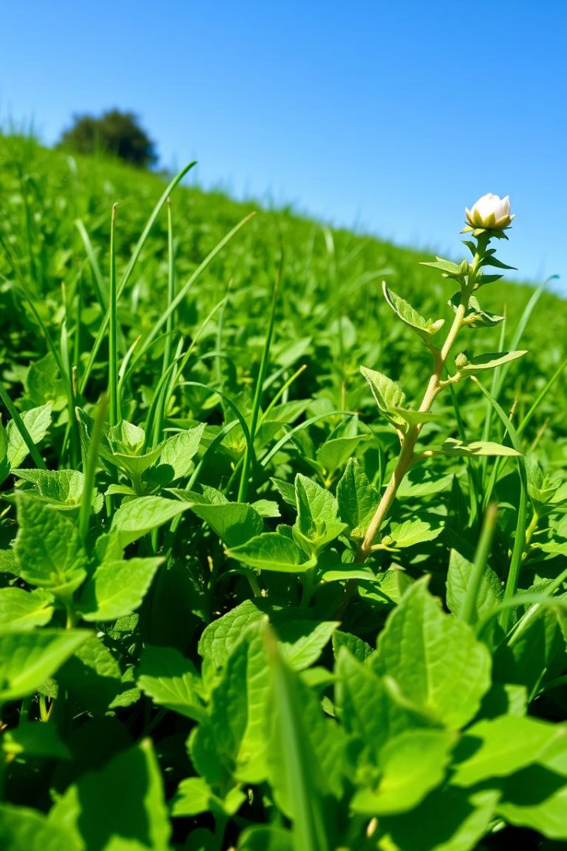
Plant Disease Detection: ML Solutions for Web & Android App
Presented By -
Nimesh Urkude – 12415602721
Jayam Shrivastav – 12115602721
Pratham Raj - 14515602721

Slide 2
The Growing Problem: Plant Diseases and Food Security
Global Impact
Economic Costs
Plant diseases cause significant crop losses worldwide.
Crop failures lead to financial hardship for farmers.
This threatens food security and economic stability.
Increased pesticide use impacts the environment.
Farmers face challenges in identifying and managing diseases effectively.
Consumers face higher food prices and reduced availability.

Slide 3
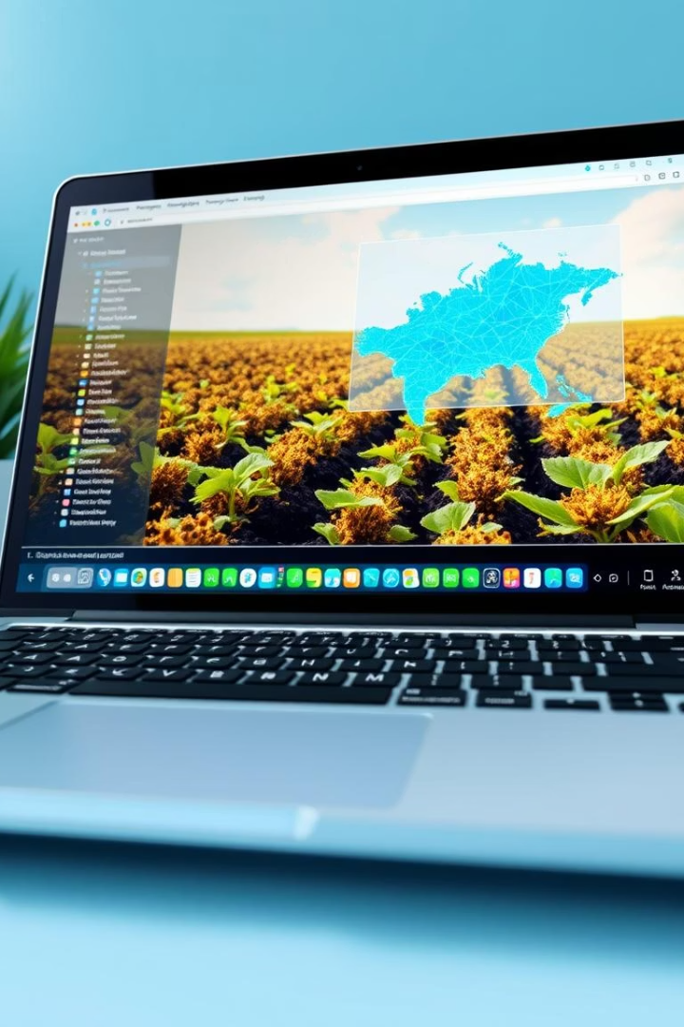
Introducing Our ML-Powered Detection System
Accuracy
Efficiency
Our system provides highly accurate disease identification with 90%+ accuracy.
Real-time analysis allows for immediate action.
Farmers can quickly address disease outbreaks and minimize losses.
It reduces the risk of misdiagnosis and delayed treatment.
Provides medicines for the diseases.
Accessibility
Available on both web and Android platforms.
Our solution provides convenient access for all users.

Slide 4
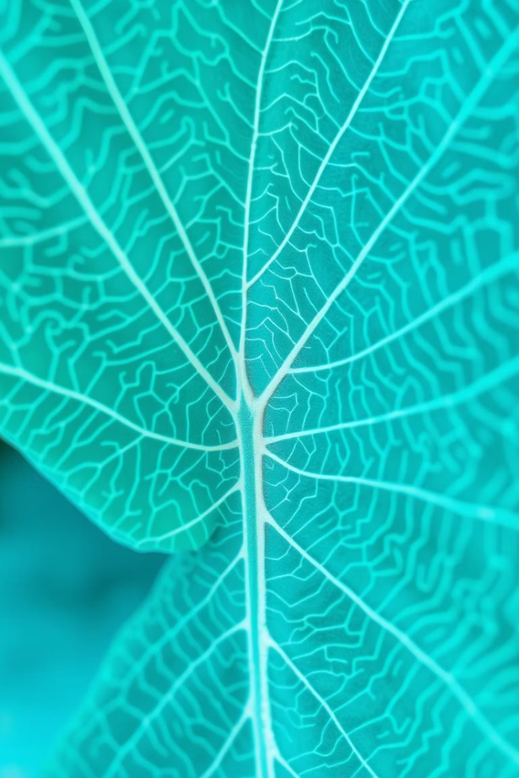





How it Works: Image Analysis and Disease Identification
Image Uploading
Users upload images of plant leaves via web or app.
Processing
Images are analyzed using advanced ML algorithms.
Identification of Disease
The system identifies potential diseases and provides the cause.
Supplements
Provides the supplements required to treat the diseases identified
Reporting
Users receive detailed reports with treatment recommendations.

Slide 5
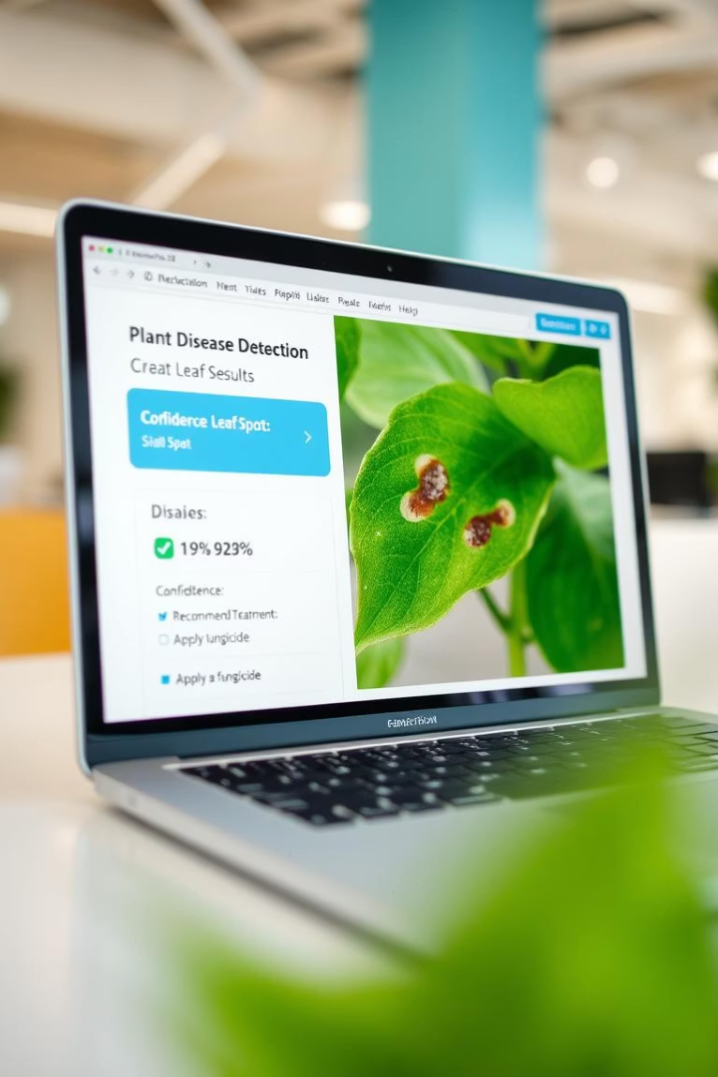



Web Application: Real-Time Analysis
User-Friendly Interface
Instant Results
Get immediate disease identification and diagnosis with a single click.
Easy-to-navigate design for seamless analysis.
Detailed Reports
Access comprehensive information on detected diseases with required supplements to treat the disease.

Slide 6
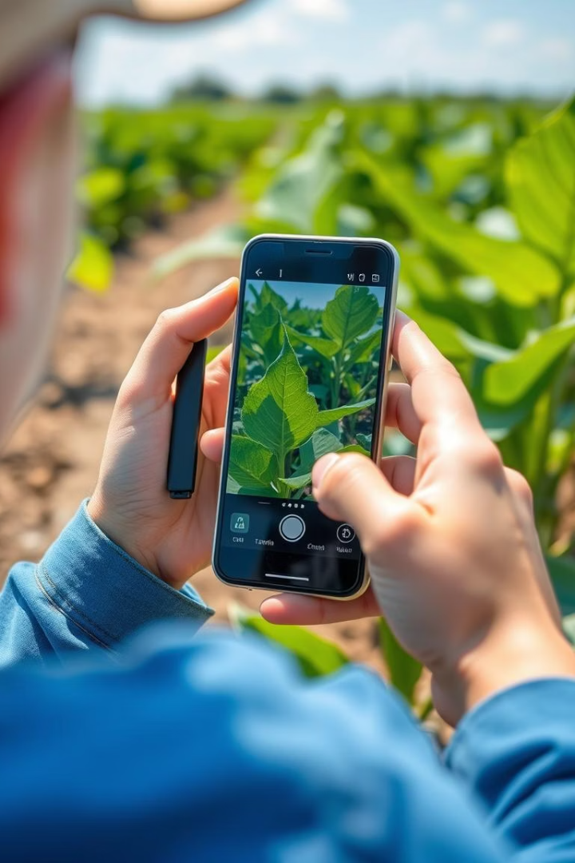
Android App Walkthrough: On-the-Go Diagnostics
1
Mobile Access
Detect diseases directly in the field using your smartphone.
2
Results in seconds
Get immediate disease identification and diagnosis with a single click.
3
Use Camera
Use your Android Device Camera to detect the diseases

Slide 7



Future Developments & Call to Action
Integration
2
Integrating with existing farm management systems.
Expansion
Adding support for more plant species and diseases.
1
Community
3
Building a platform for knowledge sharing and collaboration.

Slide 8
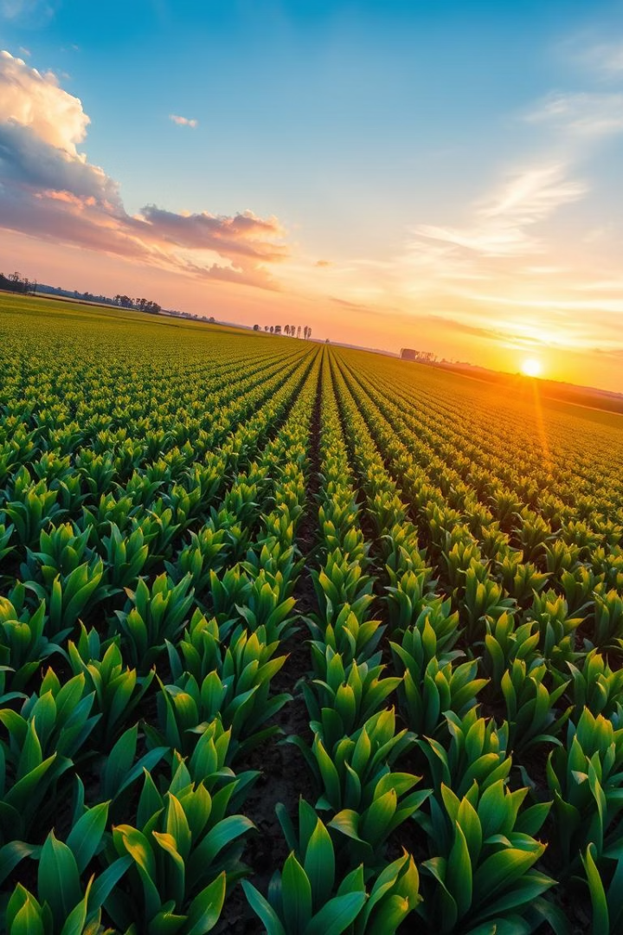
Thank You
Thank you for considering our ML-powered plant disease detection system.

